Slide 1
SMS Reminders (Alerts) using Twilio
Shashank Salian-57
Dhiren Serai-61
Havan Somaiya-63

Slide 2
Abstract
Short messaging service (SMS) (a.k.a. text messaging) is a fast, low cost and popular mode of communication among young people, and these advantages can be used in a variety of ways in sending timely reminders to the users. Most businesses will want to send an SMS or email reminder to customers before their appointment starts. This greatly helps to reduce no-shows and it can actually earn you money because you’re not losing revenue from missed appointments. Twilio is convenient, easy, and it lets you send emails and text messages to your clients to build better relationships.

Slide 3
Introduction
Twilio network uses lines that ensure direct number-to-carrier connectivity, reducing the time it takes for your SMS to arrive. No messages are lost to network outages, Twilio use Adaptive Routing technology that chooses the best path for your SMS messages.
Benefits of using Twilio:
1. Engage your customers-
2. Enable interaction
3. Reduce costs
4. Improve the customer experience

Slide 4
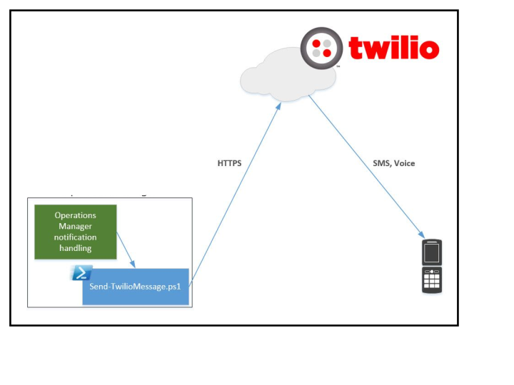
Implementation details

Slide 5
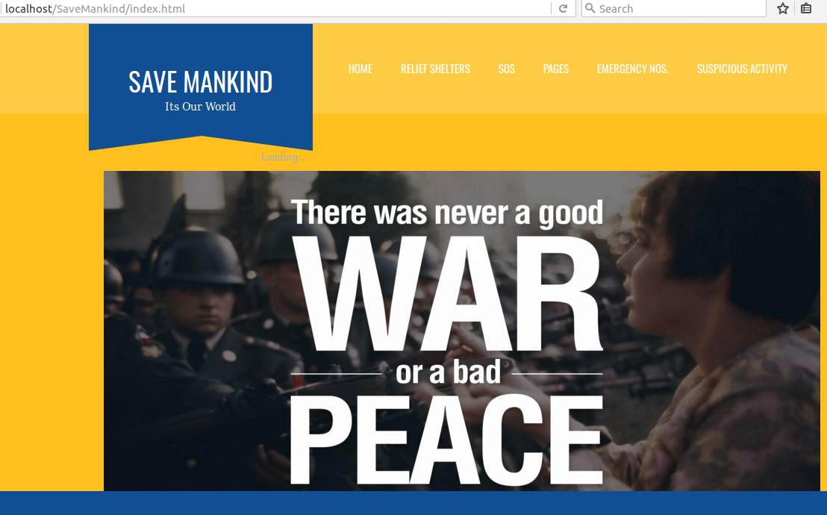
Implementation Snapshots

Slide 6
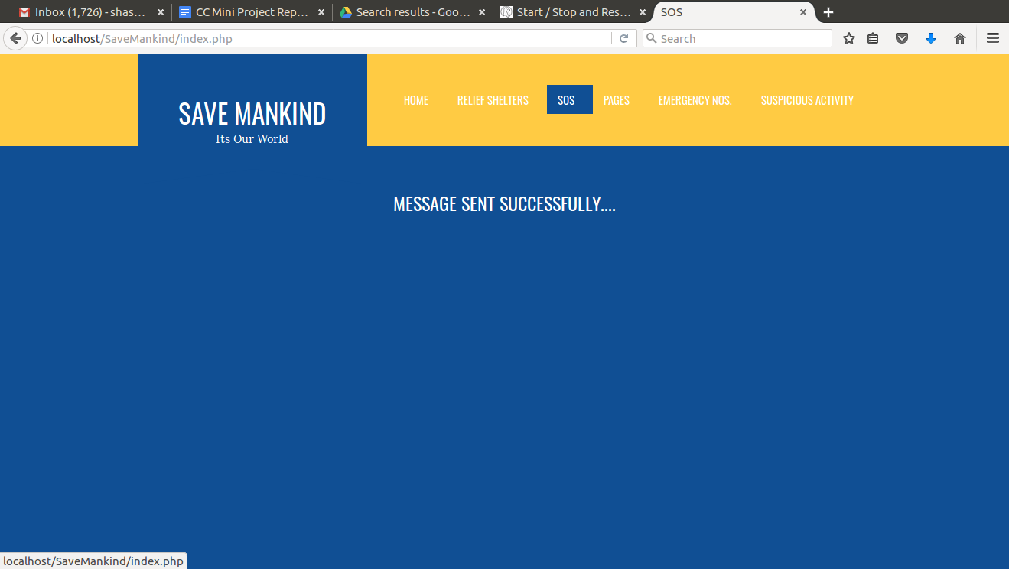
Implementation Snapshots

Slide 7
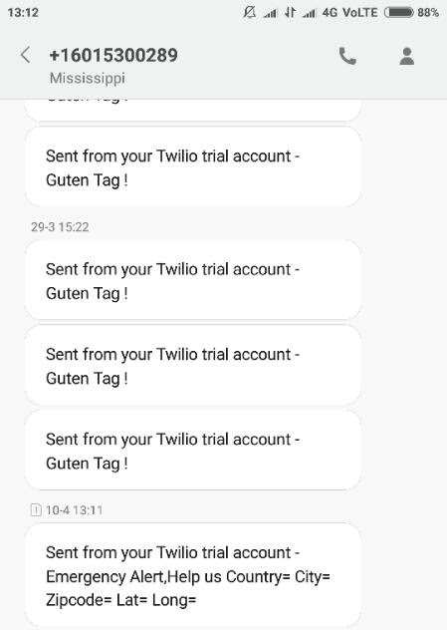
Implementation Snapshots

Slide 8
Conclusion
In the webapp for Disaster Management,we have used Twilio api for messaging service for an emergency situation.We used Twilio with php language in a webapp, as Twilio is convenient, flexible and easy.

Slide 9
Thank you!

